Slide 1
Sentiment Analysis of Book Reviews From Amazon Data
GROUP MEMBERS
13101154 Zarin Tasnim Sec: 1
14301093 Bishakha Dhar Sec:
14101107 Shandro Chakrabotry Sec: 1

Slide 2
Contributions of different members
1. Zarin Tasnim: Dataset analysis
2. Bishakha Dhar : Algorithm Analysis
3. Shandro Chakrabotry : Coding and environment set up
4. All members: Result Analysis, Presentation making & report writing

Slide 3
About our Topic
In this AI project we will do sentiment analysis of book review from Amazon dataset
We will use Naïve Bayes as the algorithm in the model
We will generate rating of a book from user sentiment using data from Twitter
Our area of work is supervised.
Our project covers Natural Language Processing(NLP), data analytics, micro-blog sentiment analysis.

Slide 4
Dataset
In this project we specifically chose Amazon book review dataset(source mentioned in the reference)
* We used the summary review as our input column.
* Columns in the dataset is related to other as it represents each customers review, rating and review summary.
* The dataset does not contain any null values.

Slide 5
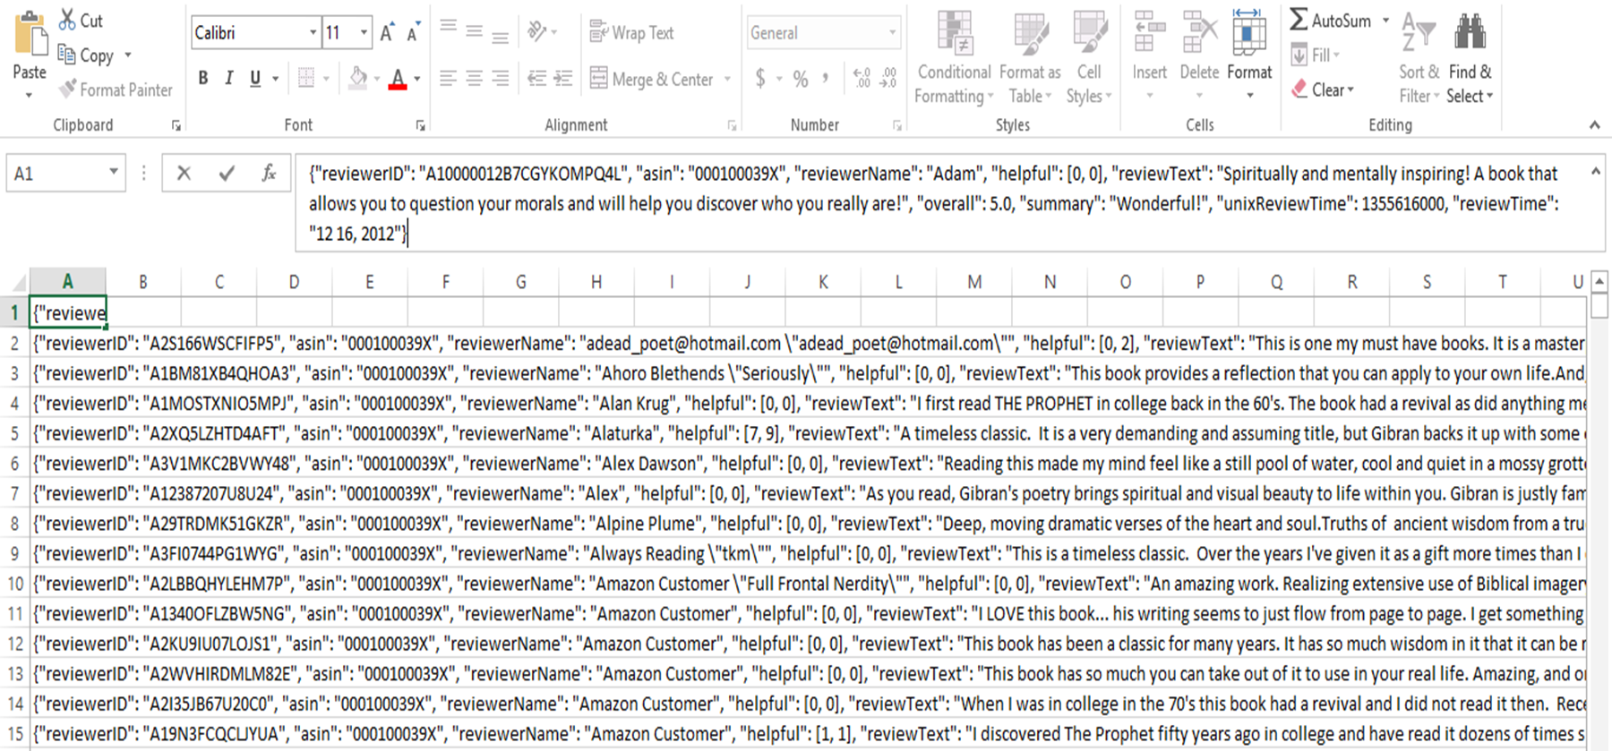
reviewerID - ID of the reviewer
asin - ID of the product (Amazon Standard Identification Number)
reviewerName - name of the reviewer
helpful - fraction of users who found it helpful
reviewText - text of the review
overall - rating of the product
summary - summary of the review
unixReviewTime - time of the review (unix time)
reviewTime - time of the review (raw)
Column in the dataset consists of:

Slide 6
Twitter Data
Scrapped Twitter data using a Twitter scrapper that allows us to scrape data about any specific topic and time frame.
As Tweets in general can be “noisy” we used NLTK in the proposed to clean the Tweet data
Lemmatization, Stop-Word Removal was used along with general cleaning like hash tag removal and removal of non-ascii characters.

Slide 7
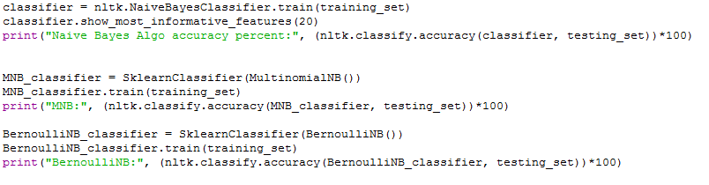
Algorithm
* Naïve-Bayes, Logistic Regression, Support Vector Machine etc fits our model.
* For our project we’ll use Naïve-Bayes algorithm.
* Naïve-Bayes is easier to implement as a probabilistic algorithm and it is also scalable to the datasets
* Naive-Bayes also is effective for prediction and with proper data pre-processing accuracy can be quite high.
* Performs well in case of categorical input variables.
* We have used python as our programming language in our project and used Sci-kit learn library to implement the algorithm.

Slide 8
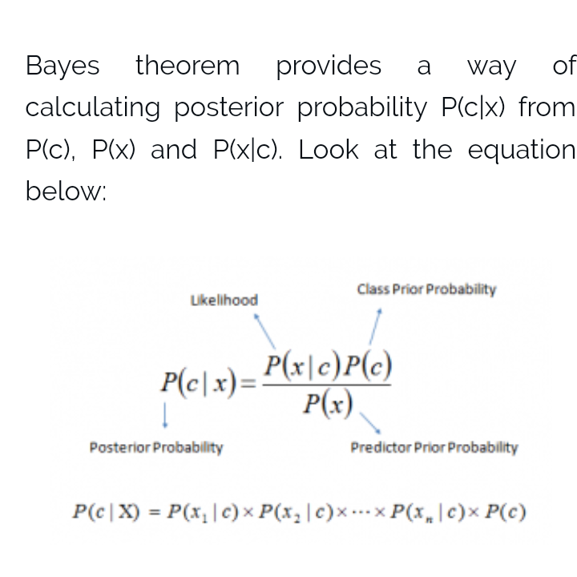
Naïve Bayes
{Based on Bayes’ Theorem}

Slide 9
Advantages
Easy and fast to predict
Performs better compare to other models
Performs well in case of categorical input variables

Slide 10
Code and Library
1. Sentiment analysis is a popular topic for research.
2. Therefore enough resources can be found in the internet.
3. We used Scikit Learn and its official documentation for implementation.
4. We created our feature set from the Amazon dataset.

Slide 11
Our Program
1. We used Sci-kit Learn as our library.
2. Sci-kit Learn has Naïve Bayes built into the library.
3. Created a feature set that consists of most frequent n-number of words.
4. Used test set for accuracy.
5. Trained classifier was used on the Twitter data for calculating polarity
6. By doing arithmetic mean we generated the ratings

Slide 12
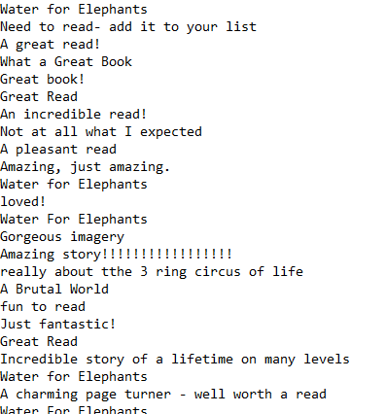
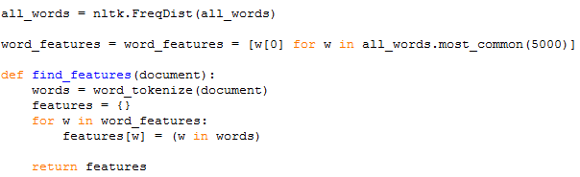

Slide 13
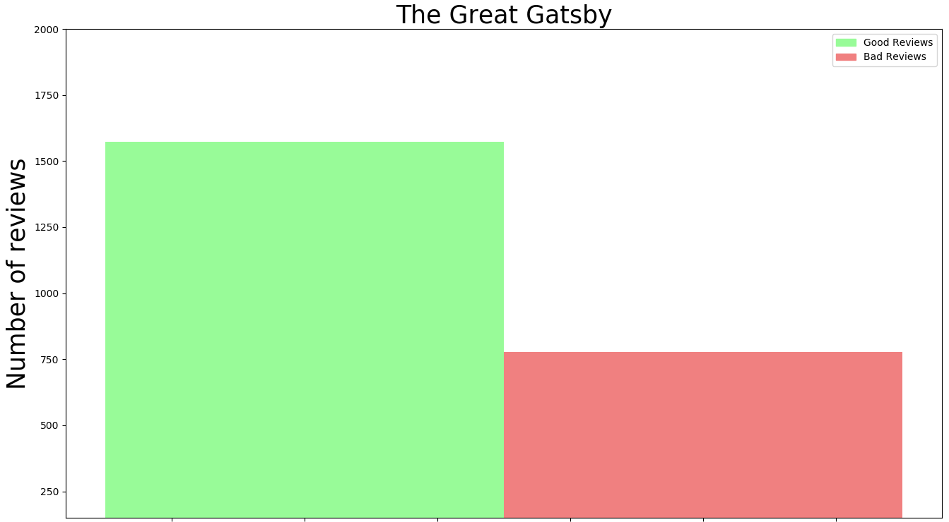
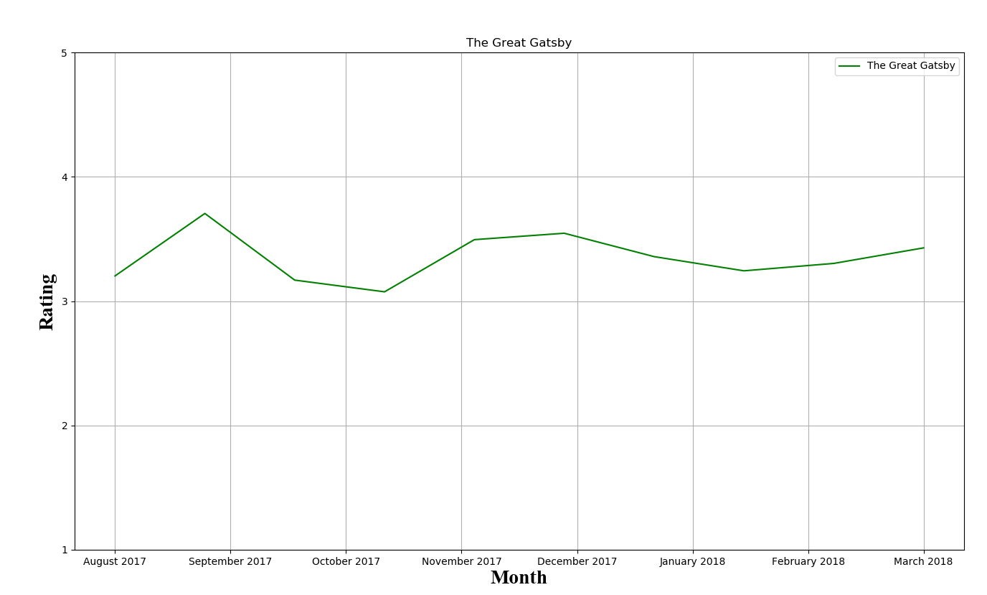
Results
Number of good reviews and bad reviews are shown here for the book The Great Gatsby along with the generated rating which shows user opinion shifting from time to time.

Slide 14
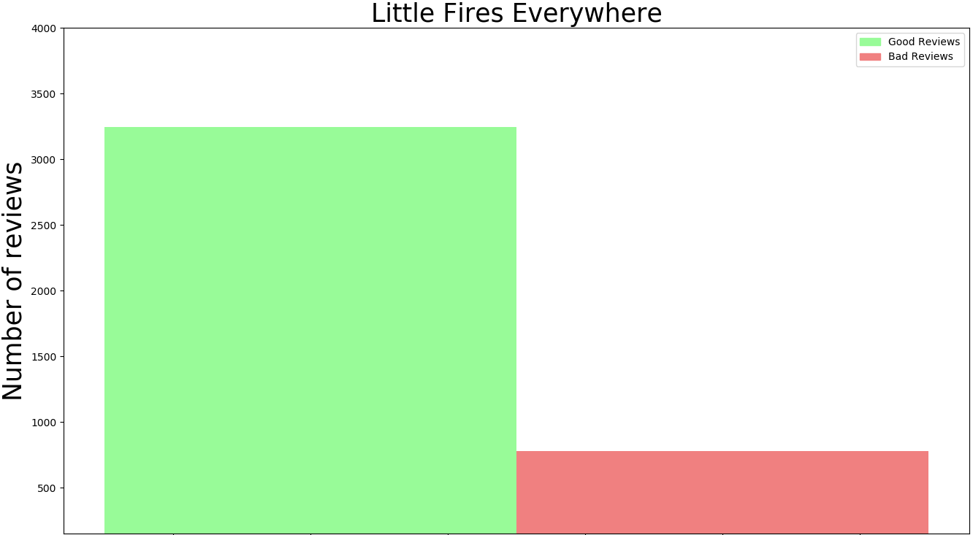
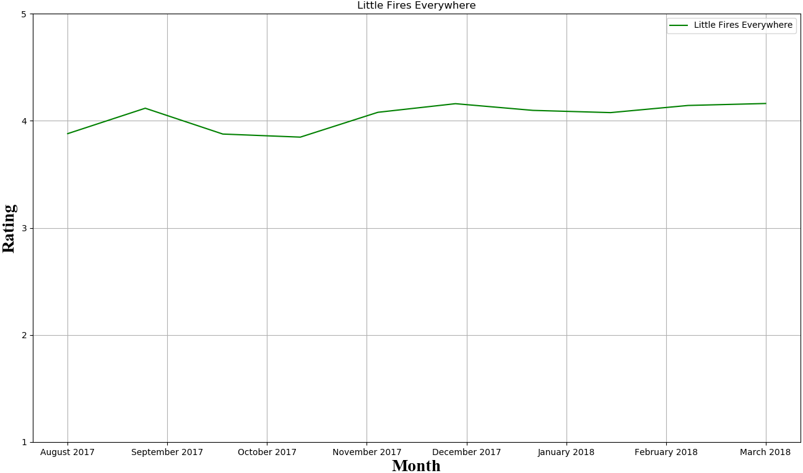
Results Cntd.
Number of good reviews and bad reviews are shown here for the book Little Fires Everywhere along with the generated rating which shows user opinion shifting from time to time.

Slide 15
Conclusion
In this model book rating has been generated from user opinion of a book
User of this model can analyze books and determine which is more
appreciated by the public.
In the future we want build on this model and create a user friendly UI
which will allow user of the model to analyze books conveniently.
To get better result we also want to implement SVM, Logistic Regression
in this model in the future.

Slide 16
Reference
1. K. L. S. Kumar, J. Desai, and J. Majumdar, “Opinion mining and sentiment analysis on online customer review,” 2016 IEEE International Conference on Computational Intelligence and Computing Research (ICCIC), 2016.
2. McAuley, J. (n.d.). Amazon product data. Retrieved March 24, 2018, from http://jmcauley.ucsd.edu/data/amazon/
3. M. Mhatre, D. Phondekar, P. Kadam, A. Chawathe, and K. Ghag, “Dimensionality reduction for sentiment analysis using pre-processing techniques,” 2017 International Conference on Computing Methodologies and Communication (ICCMC), 2017.
4. B. Liu, “Sentiment Analysis and Opinion Mining,” Synthesis Lectures on Human Language Technologies, vol. 5, no. 1, pp. 1–167, 2012.

